Slide 1
Web Automation Techniques
How to become an awesome “hacker” when it comes to web development; all the basics you need to know

Slide 2

Boring Lecture first
We need to lecture a bit so you can understand what we are doing

Slide 3
What is a webpage?
Consists of HTML, CSS, and javascript
Three main steps to showing a web page:
The browser parses the link, and fetches the static HTML document from the server
The browser parses this HTML document for links to scripts, images, and other resources it needs to render the page, and fetches those too
The web browser takes all these elements puts it together internally to create a “representation” of the webpage

Slide 4
How does a browser send data to a server?
Different protocols to transfer data over the internet (FTP(file transfer), HTTP(websites), SMTP(mail), SSH (login to remote servers)
However, we only focus on HTTP; within that, there are 2 main types of request methods(POST and GET)
90% of the information you enter into your browser is sent to a server through GET and POST http requests

Slide 5
GET and POST requests
Heart of internet website data transfer
Body contains the actual data
Requests have “headers”
Stores meta data
When you make a POST request, headers contain the data you are transfering
“user:bob” “password: hunter42”
GET embeds data into URL
Don’t want your login visible over the internet
Post requests can also send more data
Around 2 MB of data in their body
Lets look at a GET request from amazon, and a POST request from reddit

Slide 6
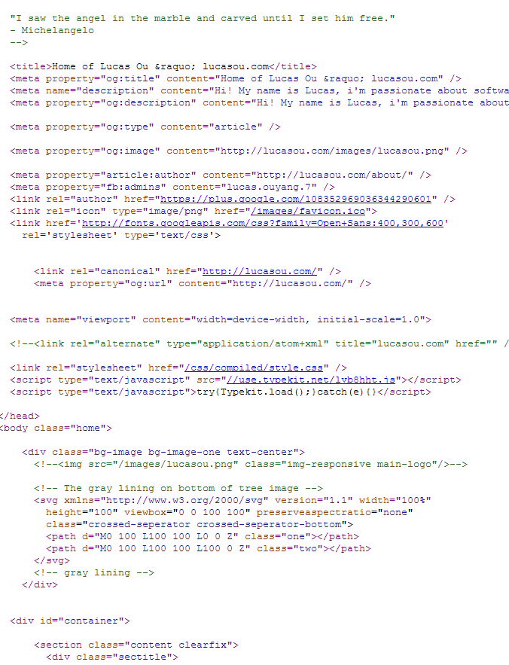
HTML
Stands for Hyper Text Markup language.
Displays the “static content” on a webpage such as formatting, text, and images
Comprised of tags (things in <>) with values
<a> tags are links, <input> tags are forms, href=“blah” is for links

Slide 7
DOM
Basically an“object” version of a webpage’s HTML
Turns HTML’s tags into an tree-like object that can easily be referenced
Used by programs to parse html
Is better than regex, because HTML cannot be parsed effectively with regex

Slide 8

Javascript
A programming language that runs in your browser
Most “important” tool when hacking together webpages
Allows you to dynamically modify the webpage based on user actions

Slide 9

Google Developer Console
You’re #1 tool for front-end web dev and hacking
Time for hands on stuff! :D
Feel free to follow along on your laptops
We’re going to explore reddit
Topics:
Elements
Network
Console

Slide 10

Selenium
A great too for “web automation”
Can be used to fill in forms, scrape data, “click” on objects that require javascript to render, etc.
Better than most other web scraping tools because it runs a full-fledged browser with JavaScript when automating
Can also cause it to be a lot slower too than a conventional scraper(don’t try spinning 1000x up on one machine!)

Slide 11
Xpath format
Most powerful way of selecting elements in a DOM
Examples:
<form id=“blah”
// specifies to return ALL matching tags, while a single / specifies to return just the first tag
@ symbol specifies the “attribute”
What is after the = symbol specifies the value of the tag
login_form = driver.find_element_by_xpath("/html/body/form[1]")
login_form = driver.find_element_by_xpath("//form[1]")
login_form = driver.find_element_by_xpath("//form[@id='loginForm']")

Slide 12
Example Time!
Lets try creating some example scripts on a websites
You will need to download firefox if you don’t already have it
You also need python 2.7
Open your favorite terminal editor
Sudo pip install –U selenium
Or use python setup.py install on
Sudo pip install requests
Same deal with
If you have python 3, use pip3
If you don’t have pip, use sudo easy_install pip
If on windows, Download get-pip.py from here:
https://bootstrap.pypa.io/get-pip.py
Then run it, and do the install for selenium and “requests”
Go to http://rocky-brook-8124.herokuapp.com/signup.html
Documentation: http://selenium-python.readthedocs.org/locating-elements.html
https://github.com/kennethreitz/requests/tarball/master
http://pypi.python.org/pypi/selenium

Slide 13
JavaScript automation is also possible
Lets look at apple.com
But really /https://jobs.apple.com/us/search

Slide 14

Move Advanced Example
Lets automate job applications!
We will automating applying to college jobs at yelp.com
Automate inputting first and last name, putting in state, uploading resume
Then see a completed version in action!

Slide 15

With great power, comes great responsibility
Be careful what you automate—you don’t want to spam employers with applications, or DDOS some poor indie developer’s server

Slide 16
Have…..you met Ted?
Time for an…interesting application of web automation

